Slide 1

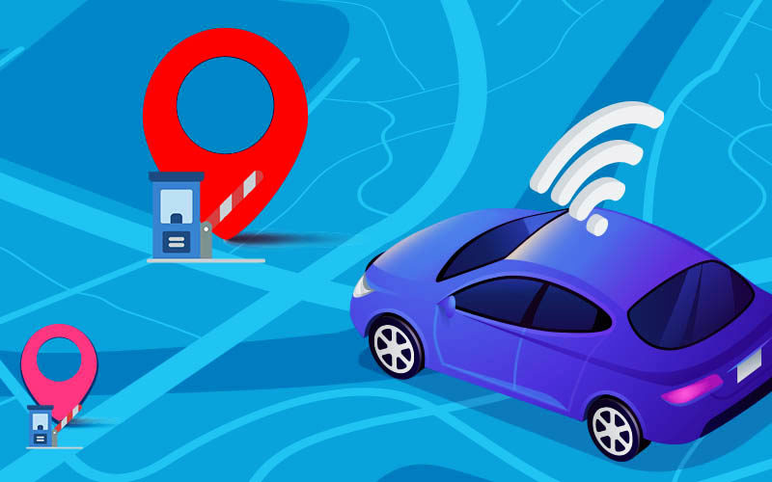
SMART INDIA HACKATHON 2024
Problem Statement ID - SIH1588
Problem Statement Title - Student Innovation
PS Category - Software
Team ID - 89
Team Name - GeoGurus

Slide 2
IDEA
GeoGurus
GPS Based Toll Tracking System
GPS technology to revolutionize highway toll collection and road safety. By automatically calculating tolls based on distance traveled and monitoring vehicle speeds, it ensures fair charges and discourages speeding.
The system delivers real-time notifications for toll deductions and penalties, eliminating the need for traditional toll booths.
This modern approach reduces traffic congestion, enhances user convenience, and promotes safer driving practices, leading to a smoother and more efficient road experience.

Slide 3
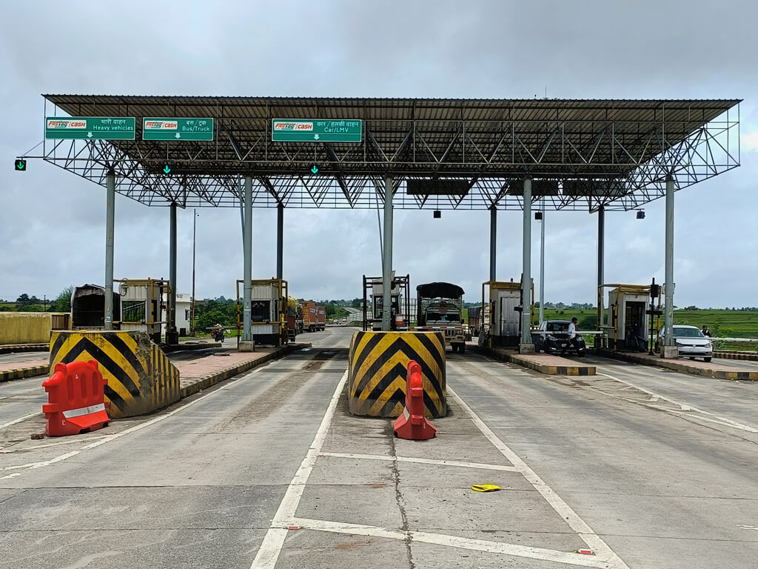
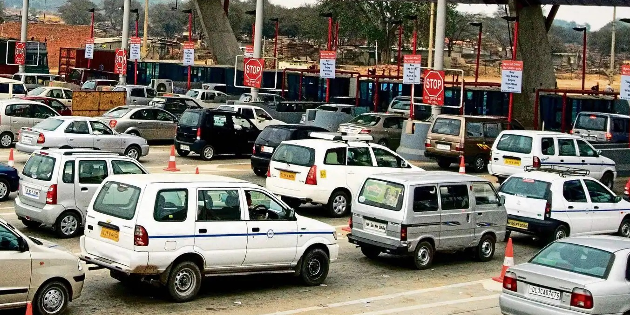
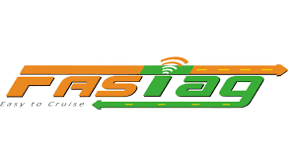
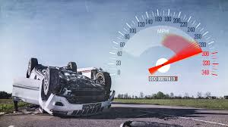
CURRENT SCENARIOS
Infrastructure
Traffic Congestion
Overspeeding

Slide 4

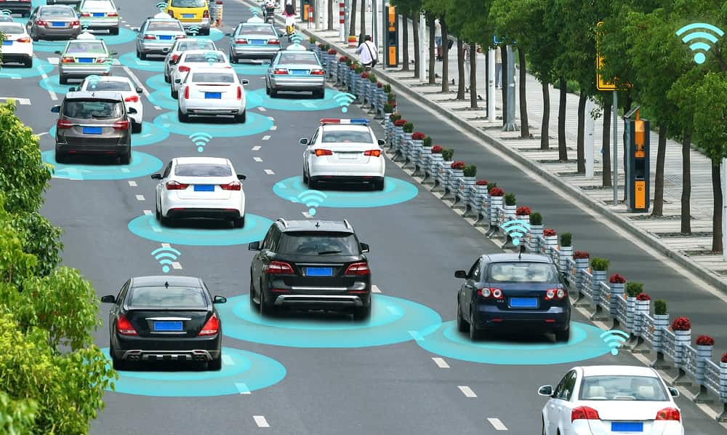

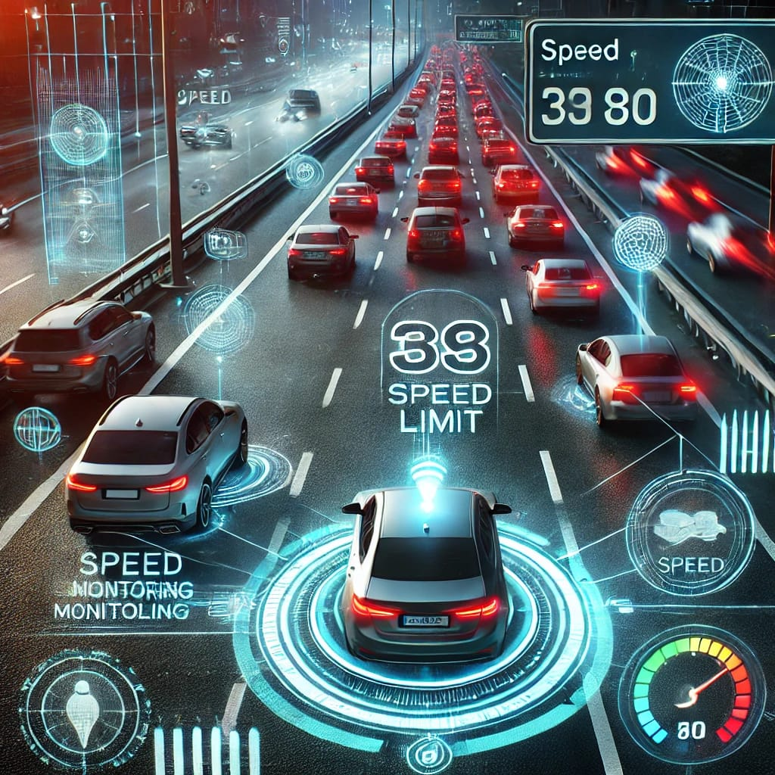
SOLUTION
Economic Efficiency
Seamless Traffic Flow
Speed Monitoring

Slide 5
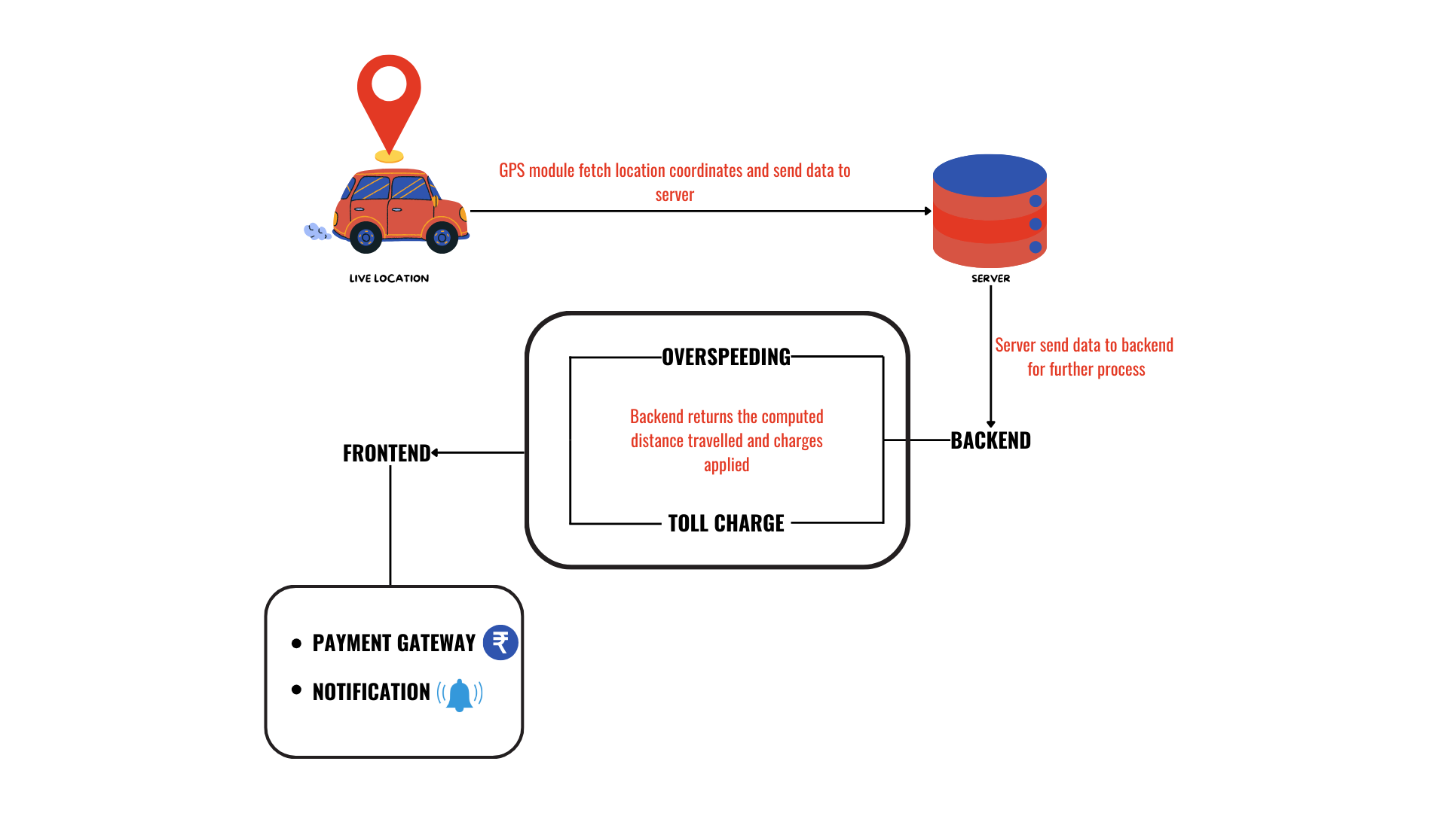
TECHNICAL APPROACH
GeoGurus
Architecture Diagram
Frontend - React
Backend - Node.js
Android Application
Firebase

Slide 6
FEASIBILITY AND VIABILITY
GeoGurus
Security
Use JWT (JSON Web Tokens) for secure authentication between the Android app, React frontend, and Node.js backend. Data in transit between the frontend and Firebase should be encrypted using HTTPS. Firebase also has built-in security rules to control who can read or write data, ensuring only authenticated users have access.
Latency
Continuous GPS updates can be handled efficiently using Firebase Realtime Database, which provides real-time synchronization.
Database Handling
Using unstructured data we can easily store dynamic data.
Using time-based constraints can help to manage computational complexity.

Slide 7
IMPACTS AND BENEFITS
GeoGurus
impacts
Economic Impact
Reduces cost of construction and maintenance of toll booth.
Elimination of corruption through cashless transaction and transparent billing.
Environmental Impact
Lesser fuel consumption and lower carbon emissions.
Social Impact
Supports law enforcement in maintaining safer roads.
Benefits
Real-time monitoring of vehicle speeds can help track and penalize overspeeding vehicles, which improves overall safety.
Lesser jams at highways owing to lesser congestion on roads.
Vehicles will be more secure and safe as they will always be tracked by GPS.
In the case of thefts, owners can easily find out the location of their vehicles due to easy tracking by GPS.

Slide 8
COMPARATIVE STUDY
GeoGurus
Existing System | GeoToll System
Use of RFID tags, manual payments or cash. | Use of GPS system in vehicles, automatic payment deduction.
Requires physical device (tag) or stops at booths. | Seamless, no stops required, system does tracking.
Detected only when a vehicle approach a toll booth. | Entire travel route to be tracked.
Limited to roads with toll booth. | Can be implemented on any road, nationwide.
Higher operational costs (staff, equipment, maintenance) | Lower operational costs, less physical infrastructure.
Easier to cheat by avoiding toll booths or messing with RFID tags. | Malpractice is avoided.

Slide 9
RESEARCH AND REFERENCES
GeoGurus
1) Tan, Jin Yeong, et al.“GPS-based highway toll collection system: Novel design and operation.”Cogent Engineering 4.1 (2017): 1326199
2) Goutham, K., and M. Gowtham. "GPS Based E-Toll Gate collection System." 2023 2nd International Conference on Vision Towards Emerging Trends in Communication and Networking Technologies (ViTECoN). IEEE, 2023.
3) Subha, R., et al. "Smart Toll Collection: A GPS Based Automated System." 2023 International Conference on the Confluence of Advancements in Robotics, Vision and Interdisciplinary Technology Management (IC-RVITM). IEEE, 2023.

